Slide 1
JAVA PROJECT OVERVIEW
VoteSecure: Student Council Election Tally System
Automating and securing educational institution elections using robust Object-Oriented Java architecture.

Slide 2
VOTESECURE – STUDENT COUNCIL ELECTION
Project Details
G. Sai Kiran – 2600031707
V. Satya Sandeep – 2600031752
T. Y. Naga Sai – 2600031601
K. Lekha – 2600031634
Department: Basic Engineering Sciences-1
University: KL University
Course: Problem Solving using Programming (JAVA)
Academic Year: 2026–2027
VOTESECURE
FACULTY MENTOR
Dr. D. Anand
Page 1 / 13

Slide 3
SYSTEM INTRODUCTION
Project Overview & Objectives
Core Purpose
Security & Fairness
OOP Foundation
Automates and simplifies the student council election lifecycle in educational institutions from registration to result publication.
Ensures eligible students vote only once per position through robust verification checks and duplicate vote prevention.
Built using Classes, Inheritance, Encapsulation, Java Collections, Exception Handling, Lambda Expressions, and Stream API.

Slide 4
SYSTEM PILLARS
Goals & Key Features
Fairness
Efficiency
Transparency
Strict eligibility validation and duplicate-vote prevention guarantees secure and trustworthy outcomes.
Drastically reduces manual work, automates vote counting, and speeds up tallying processes.
Provides clear summaries, robust search tools, and detailed reports of election results.

Slide 5
TECHNICAL ARCHITECTURE
Java & OOP Concepts Used
Classes & Objects
Encapsulation
Collections & API
Exception Handling
Represents students, candidates, elections, and results.
Keeps data and related operations secure inside classes.
Uses List, Map, Lambda Expressions, and Stream API for data analysis.
Robustly handles console input errors and supports file storage.

Slide 6
MODULAR STRUCTURE
Ten Core System Modules
1. Student Module
6. ValidateService Module
2. Candidate Module
7. SearchService Module
3. Election Module
8. ReportGenerationService Module
4. Vote Tally Module
9. AnalysisService Module
5. Result Module
10. Main Module

Slide 7
MODULE DETAILS
Student & Candidate Modules
Student Module
Candidate Module
Maintains student records, stores academic details, and verifies voter eligibility via registerStudent() and verifyEligibility().
Manages candidate nominations across council positions with manifesto tracking via nominateCandidate() and withdrawCandidate().

Slide 8
MODULE DETAILS
Election & Vote Tally Modules
Election Module
Vote Tally Module
Schedules and manages election events, timelines, and status updates through scheduleElection(), startElection(), and endElection().
Records student votes securely and counts candidate tallies accurately via castVote() and countVotes().

Slide 9
MODULE DETAILS
Result & Validation Modules
Result Module
ValidateService Module
Declares election winners and publishes final vote counts using calculateWinner() and publishResult().
Performs rigorous pre-processing checks on student IDs, voting status, and duplicate votes to maintain integrity.

Slide 10
ADVANCED SERVICES
Search, Report & Analysis
SearchService
ReportService
AnalysisService
Provides rapid search across student, candidate, and election collections.
Generates comprehensive candidate and voting result reports.
Computes voter turnout percentages and statistical insights via Stream API.

Slide 11
PROCESS PIPELINE
End-to-End Election Workflow
STEP 01
STEP 02
STEP 03
STEP 04
Nominate Candidates
STEP 05
Register Students
Schedule Election
Validate & Cast
Publish Results
Create verified voter records.
Record positions & manifestos.
Set date, position & status.
Check eligibility & record vote.
Declare winner & reports.

Slide 12
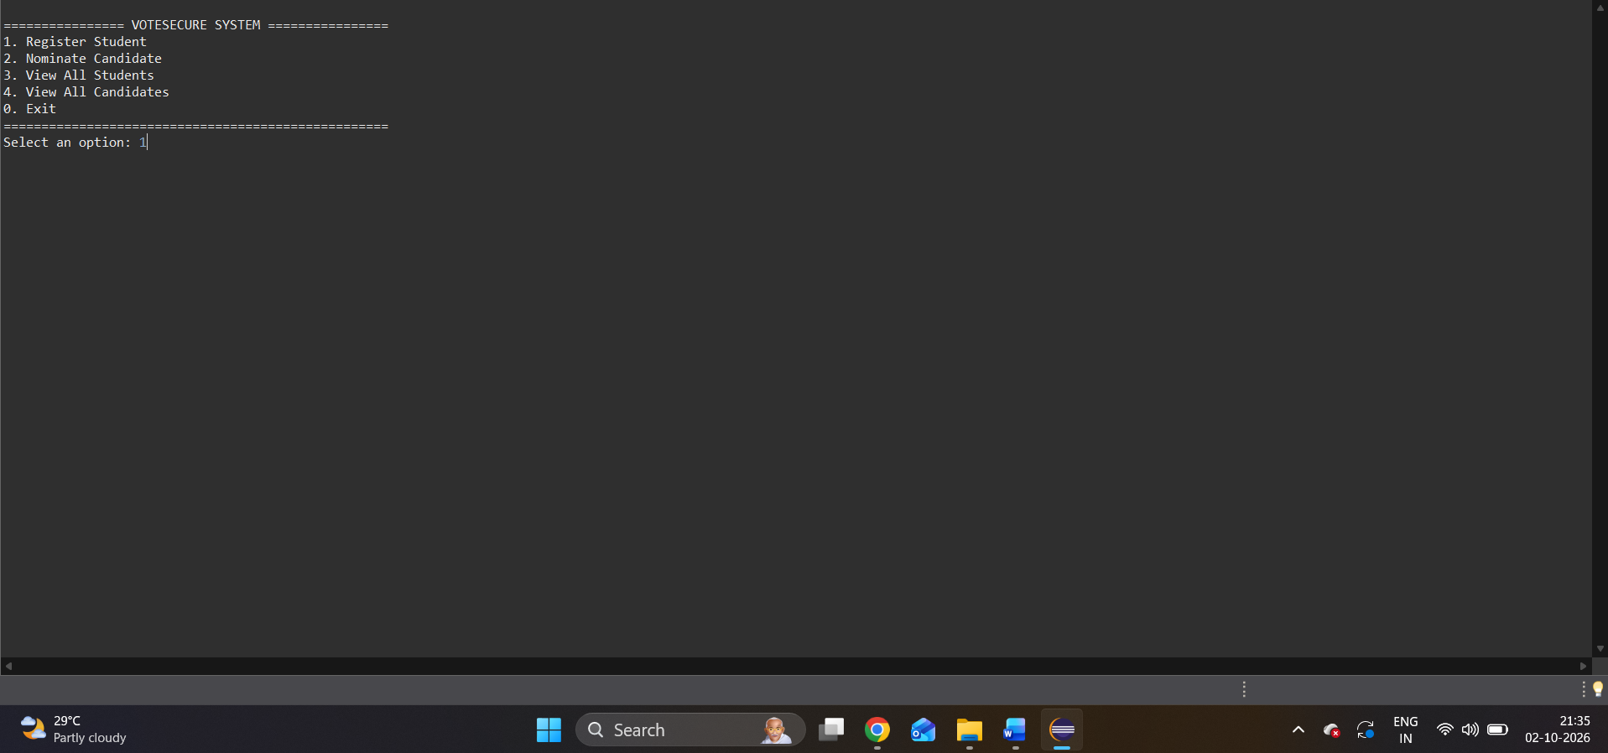
INTEGRATION AND SYSTEM TESTINGOUTPUTS

Slide 13
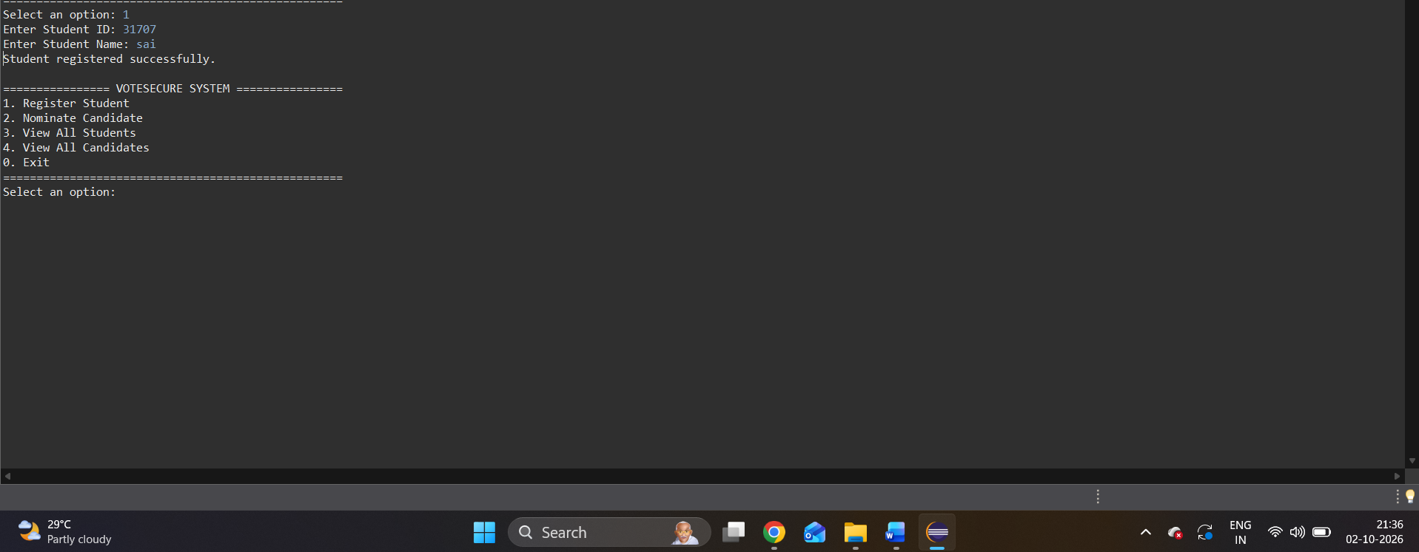

Slide 14
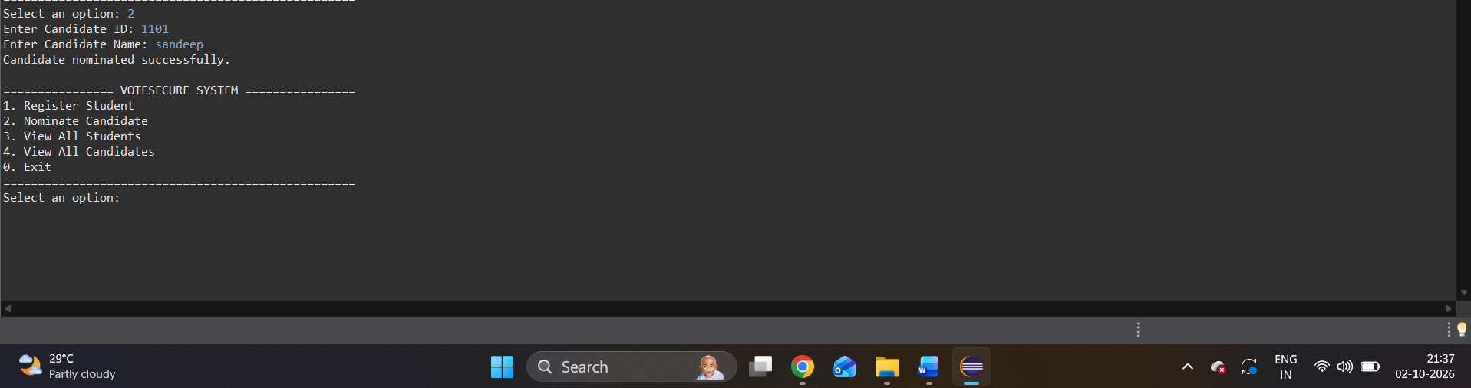

Slide 15
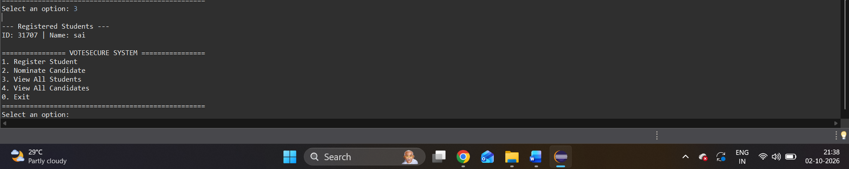

Slide 16
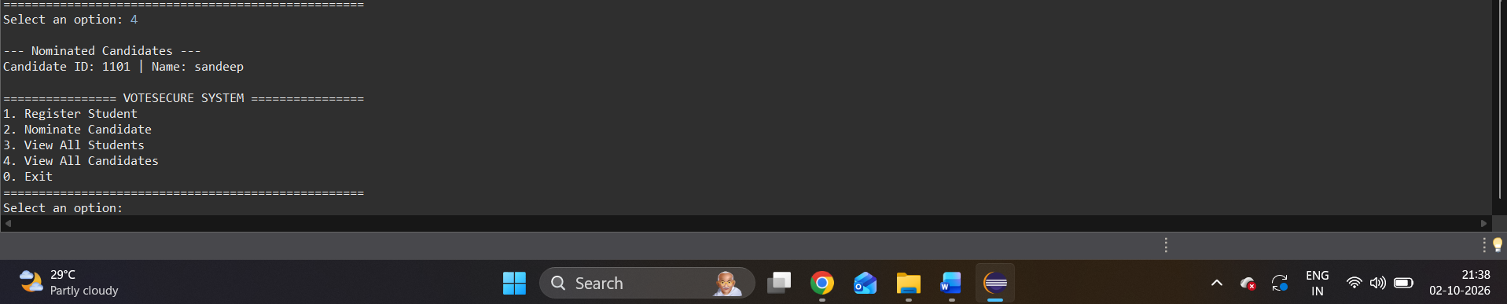

Slide 17


Slide 18
HTML
<!DOCTYPE html>
<html>
<head>
<title>VoteSecure - Student Election</title>
<meta name="viewport" content="width=device-width, initial-scale=1">
<link rel="stylesheet" href="style.css">
</head>
<body>
<header>
<h1>VoteSecure</h1>
<p>Student Council Election Tally System</p>
</header>
<nav>
<a href="#students">Students</a>
<a href="#candidates">Candidates</a>
<a href="#elections">Elections</a>
<a href="#vote">Cast Vote</a>
<a href="#results">Results</a>
<a href="#reports">Reports</a>
</nav>
<main>
<section class="intro">
<h2>Welcome to VoteSecure</h2>
<p>Manage student council elections easily.</p>
<div class="summary">
<div class="summary-box">
<h3 id="studentTotal">0</h3>
<p>Students</p>
</div>
<div class="summary-box">
<h3 id="candidateTotal">0</h3>
<p>Candidates</p>
</div>
<div class="summary-box">
<h3 id="electionTotal">0</h3>
<p>Elections</p>
</div>
<div class="summary-box">
<h3 id="voteTotal">0</h3>
<p>Votes</p>
</div>
</div>
</section>
<!-- Student Module -->
<section id="students" class="panel">
<h2>1. Student Module</h2>

Slide 19
<p>Register students for the election.</p>
<form id="studentForm">
<label>Student ID</label>
<input type="text" id="studentId" required>
<label>Student Name</label>
<input type="text" id="studentName" required>
<label>Department</label>
<input type="text" id="department" required>
<label>Academic Year</label>
<select id="studentYear" required>
<option value="">Select Year</option>
<option>1st Year</option>
<option>2nd Year</option>
<option>3rd Year</option>
<option>4th Year</option>
</select>
<button type="submit">Register Student</button>
</form>
<h3>Registered Students</h3>
<table>
<thead>
<tr>
<th>ID</th>
<th>Name</th>
<th>Department</th>
<th>Year</th>
</tr>
</thead>
<tbody id="studentTable"></tbody>
</table>
</section>
<!-- Candidate Module -->
<section id="candidates" class="panel">
<h2>2. Candidate Module</h2>
<p>Register nominated candidates.</p>
<form id="candidateForm">
<label>Candidate ID</label>
<input type="text" id="candidateId" required>
<label>Candidate Name</label>
<input type="text" id="candidateName" required>
<label>Department</label>
<input type="text" id="candidateDepartment" required>

Slide 20
<label>Position</label>
<input type="text" id="candidatePosition"
placeholder="Example: President" required>
<label>Manifesto</label>
<textarea id="manifesto" required></textarea>
<button type="submit">Nominate Candidate</button>
</form>
<h3>Nominated Candidates</h3>
<table>
<thead>
<tr>
<th>ID</th>
<th>Name</th>
<th>Department</th>
<th>Position</th>
<th>Manifesto</th>
</tr>
</thead>
<tbody id="candidateTable"></tbody>
</table>
</section>
<!-- Election Module -->
<section id="elections" class="panel">
<h2>3. Election Module</h2>
<p>Create and schedule elections.</p>
<form id="electionForm">
<label>Election ID</label>
<input type="text" id="electionId" required>
<label>Election Name</label>
<input type="text" id="electionName" required>
<label>Position</label>
<input type="text" id="electionPosition" required>
<label>Starting Date</label>
<input type="datetime-local" id="startDate" required>
<label>Ending Date</label>
<input type="datetime-local" id="endDate" required>
<button type="submit">Create Election</button>
</form>
<h3>Election Schedule</h3>
<table>
<thead>
<tr>
<th>ID</th>

Slide 21
<th>Name</th>
<th>Position</th>
<th>Start</th>
<th>End</th>
<th>Status</th>
</tr>
</thead>
<tbody id="electionTable"></tbody>
</table>
</section>
<!-- Vote Tally Module -->
<section id="vote" class="panel">
<h2>4. Vote Tally Module</h2>
<form id="voteForm">
<label>Select Election</label>
<select id="voteElection" required></select>
<label>Student ID</label>
<select id="voterId" required></select>
<label>Select Candidate</label>
<select id="voteCandidate" required></select>
<button type="submit">Submit Vote</button>
</form>
<p class="note">
Each student can vote only once in an election.
</p>
</section>
<!-- Result Module -->
<section id="results" class="panel">
<h2>5. Result Module</h2>
<label>Select Election</label>
<select id="resultElection"></select>
<div id="resultArea">
Select an election to view results.
</div>
</section>
<!-- Search and Report Module -->
<section id="reports" class="panel">
<h2>6. Search and Report Module</h2>
<input type="text" id="searchBox"
placeholder="Search by student or candidate name or ID">
<div id="searchResults"></div>
<h3>Election Summary</h3>
<div id="reportArea"></div>

Slide 22
</section>
</main>
<footer>
<p>VoteSecure - Student Project</p>
</footer>
<script src="script.js"></script>
</body>
</html>

Slide 23
CSS
body {
font-family: Arial, sans-serif;
background-color: #f2f2f2;
margin: 0;
color: #222;
}
header {
background-color: #243b55;
color: white;
text-align: center;
padding: 22px;
}
header h1 {
margin: 0;
}
nav {
background-color: #182b40;
padding: 12px;
text-align: center;
}
nav a {
color: white;
text-decoration: none;
margin: 8px 12px;
display: inline-block;
}
nav a:hover {
text-decoration: underline;
}
main {
width: 85%;
max-width: 1100px;
margin: 25px auto;
}
.intro, .panel {
background-color: white;
padding: 20px;
margin-bottom: 22px;
border-radius: 6px;
}
h2 {
color: #243b55;

Slide 24
}
.summary {
display: flex;
gap: 12px;
flex-wrap: wrap;
margin-top: 20px;
}
.summary-box {
background-color: #e8eef4;
padding: 12px;
text-align: center;
flex: 1;
min-width: 120px;
border-radius: 5px;
}
.summary-box h3 {
color: #243b55;
font-size: 25px;
margin: 5px;
}
form {
max-width: 600px;
}
label {
display: block;
margin-top: 12px;
margin-bottom: 5px;
}
input, select, textarea {
width: 100%;
box-sizing: border-box;
padding: 10px;
border: 1px solid #bbb;
border-radius: 4px;
font-size: 15px;
}
button {
background-color: #243b55;
color: white;
border: none;
padding: 10px 16px;
margin-top: 15px;
border-radius: 4px;
cursor: pointer;
}
button:hover {
background-color: #42678c;
}

Slide 25
table {
width: 100%;
border-collapse: collapse;
margin-top: 12px;
}
th, td {
border: 1px solid #ddd;
padding: 10px;
text-align: left;
}
th {
background-color: #e8eef4;
}
tr:nth-child(even) {
background-color: #f8f8f8;
}
.note {
color: #666;
font-size: 13px;
}
#resultArea, #searchResults, #reportArea {
margin-top: 15px;
line-height: 1.7;
}
footer {
background-color: #243b55;
color: white;
text-align: center;
padding: 12px;
}
@media (max-width: 650px) {
main {
width: 92%;
}
nav a {
margin: 6px;
}
table {
font-size: 12px;
}
}

Slide 26
JAVA SCRIPT
// Store project details in browser
let students = JSON.parse(localStorage.getItem("students")) || [];
localStorage.removeItem("students");
let candidates = JSON.parse(localStorage.getItem("candidates")) || [];
localStorage.removeItem("candidates");
let elections = JSON.parse(localStorage.getItem("elections")) || [];
localStorage.removeItem("elections");
let votes = JSON.parse(localStorage.getItem("votes")) || [];
localStorage.removeItem("votes");
// Save information
function saveData() {
localStorage.setItem("students", JSON.stringify(students));
localStorage.setItem("candidates", JSON.stringify(candidates));
localStorage.setItem("elections", JSON.stringify(elections));
localStorage.setItem("votes", JSON.stringify(votes));
}
// Add data to table
function addCell(row, value) {
let cell = document.createElement("td");
cell.textContent = value;
row.appendChild(cell);
}
// Display Students
function showStudents() {
let table = document.getElementById("studentTable");
table.innerHTML = "";
students.forEach(function(student) {
let row = document.createElement("tr");
addCell(row, student.id);
addCell(row, student.name);
addCell(row, student.department);
addCell(row, student.year);
table.appendChild(row);
});
}
// Display Candidates
function showCandidates() {
let table = document.getElementById("candidateTable");
table.innerHTML = "";
candidates.forEach(function(candidate) {
let row = document.createElement("tr");
addCell(row, candidate.id);
addCell(row, candidate.name);

Slide 27
table.appendChild(row);
});
}
// Check election status
function electionStatus(election) {
let now = new Date();
let start = new Date(election.start);
let end = new Date(election.end);
if (now < start) {
return "Scheduled";
} else if (now > end) {
return "Closed";
} else {
return "Open";
}
}
// Display Elections
function showElections() {
let table = document.getElementById("electionTable");
table.innerHTML = "";
elections.forEach(function(election) {
let row = document.createElement("tr");
addCell(row, election.id);
addCell(row, election.name);
addCell(row, election.position);
addCell(row, new Date(election.start).toLocaleString());
addCell(row, new Date(election.end).toLocaleString());
addCell(row, electionStatus(election));
table.appendChild(row);
});
}
// Add options to dropdown
function addOption(select, value, label) {
let option = document.createElement("option");
option.value = value;
option.textContent = label;
select.appendChild(option);
}
// Update dropdown lists
function updateDropdowns() {
let electionSelect = document.getElementById("voteElection");
let resultSelect = document.getElementById("resultElection");
let studentSelect = document.getElementById("voterId");
electionSelect.innerHTML = "";
resultSelect.innerHTML = "";

Slide 28
studentSelect.innerHTML = "";
addOption(electionSelect, "", "Choose an election");
addOption(resultSelect, "", "Choose an election");
addOption(studentSelect, "", "Choose a student");
elections.forEach(function(election) {
addOption(electionSelect, election.id, election.name);
addOption(resultSelect, election.id, election.name);
});
students.forEach(function(student) {
addOption(
studentSelect,
student.id,
student.id + " - " + student.name
);
});
updateCandidateOptions();
}
// Show candidates for selected position
function updateCandidateOptions() {
let electionId = document.getElementById("voteElection").value;
let election = elections.find(function(item) {
return item.id === electionId;
});
let select = document.getElementById("voteCandidate");
select.innerHTML = "";
addOption(select, "", "Choose a candidate");
if (election) {
candidates.forEach(function(candidate) {
if (candidate.position.toLowerCase() ===
election.position.toLowerCase()) {
addOption(select, candidate.id, candidate.name);
}
});
}
}
// Register Student
document.getElementById("studentForm").addEventListener("submit", function(event) {
event.preventDefault();
let id = document.getElementById("studentId").value;
let name = document.getElementById("studentName").value;
let department = document.getElementById("department").value;
let year = document.getElementById("studentYear").value;
// Check duplicate ID

Slide 29
for (let i = 0; i < students.length; i++) {
if (students[i].id === id) {
alert("Student ID already exists!");
return;
}
}
// Create student object
let student = {
id: id,
name: name,
department: department,
year: year
};
// Add student
students.push(student);
// Save student data
saveData();
// Display student
displayStudents();
// Update dashboard
updateSummary();
// Clear form
document.getElementById("studentForm").reset();
alert("Student registered successfully!");
});
// Display students in table
function displayStudents() {
let table = document.getElementById("studentTable");
table.innerHTML = "";
for (let i = 0; i < students.length; i++) {
let row = document.createElement("tr");
row.innerHTML =
"<td>" + students[i].id + "</td>" +
"<td>" + students[i].name + "</td>" +
"<td>" + students[i].department + "</td>" +
"<td>" + students[i].year + "</td>";
table.appendChild(row);
}
}

Slide 30
// Nominate Candidate
document.getElementById("candidateForm").addEventListener(
"submit", function(event) {
event.preventDefault();
let id = document.getElementById("candidateId").value.trim();
if (candidates.some(function(candidate) {
return candidate.id === id;
})) {
alert("Candidate ID already exists.");
return;
}
candidates.push({
id: id,
name: document.getElementById("candidateName").value.trim(),
department: document.getElementById("candidateDepartment").value.trim(),
position: document.getElementById("candidatePosition").value.trim(),
manifesto: document.getElementById("manifesto").value.trim()
});
saveData();
this.reset();
refreshPage();
alert("Candidate nominated successfully.");
});
// Create Election
document.getElementById("electionForm").addEventListener(
"submit", function(event) {
event.preventDefault();
let id = document.getElementById("electionId").value.trim();
let start = document.getElementById("startDate").value;
let end = document.getElementById("endDate").value;
if (elections.some(function(election) {
return election.id === id;
})) {
alert("Election ID already exists.");
return;
}
if (new Date(end) <= new Date(start)) {
alert("End date must be after start date.");
return;
}
elections.push({
id: id,
name: document.getElementById("electionName").value.trim(),
position: document.getElementById("electionPosition").value.trim(),

Slide 31
start: start,
end: end
});
saveData();
this.reset();
refreshPage();
alert("Election created successfully.");
});
// Change candidate list when election changes
document.getElementById("voteElection").addEventListener(
"change", updateCandidateOptions
);
// Cast Vote
document.getElementById("voteForm").addEventListener(
"submit", function(event) {
event.preventDefault();
let electionId = document.getElementById("voteElection").value;
let studentId = document.getElementById("voterId").value;
let candidateId = document.getElementById("voteCandidate").value;
let election = elections.find(function(item) {
return item.id === electionId;
});
if (!election || !studentId || !candidateId) {
alert("Please fill all voting details.");
return;
}
if (electionStatus(election) !== "Open") {
alert("Voting is not open.");
return;
}
let student = students.find(function(item) {
return item.id === studentId;
});
if (!student) {
alert("Student is not registered.");
return;
}
// Check if student already voted
let alreadyVoted = votes.some(function(vote) {
return vote.electionId === electionId &&
vote.studentId === studentId;
});
if (alreadyVoted) {

Slide 32
alert("You have already voted in this election.");
return;
}
let candidate = candidates.find(function(item) {
return item.id === candidateId &&
item.position.toLowerCase() ===
election.position.toLowerCase();
});
if (!candidate) {
alert("Invalid candidate selection.");
return;
}
votes.push({
electionId: electionId,
studentId: studentId,
candidateId: candidateId
});
saveData();
this.reset();
updateDropdowns();
showResults();
showReport();
updateSummary();
alert("Vote submitted successfully.");
});
// Show Results
document.getElementById("resultElection").addEventListener(
"change", showResults
);
function showResults() {
let electionId = document.getElementById("resultElection").value;
let area = document.getElementById("resultArea");
area.innerHTML = "";
let election = elections.find(function(item) {
return item.id === electionId;
});
if (!election) {
area.textContent = "Select an election to view results.";
return;
}
let heading = document.createElement("h3");
heading.textContent = election.name + " - " + election.position;
area.appendChild(heading);
let electionVotes = votes.filter(function(vote) {

Slide 33
return vote.electionId === electionId;
});
let counts = candidates
.filter(function(candidate) {
return candidate.position.toLowerCase() ===
election.position.toLowerCase();
})
.map(function(candidate) {
let total = electionVotes.filter(function(vote) {
return vote.candidateId === candidate.id;
}).length;
return {
name: candidate.name,
total: total
};
});
counts.sort(function(a, b) {
return b.total - a.total;
});
if (counts.length === 0) {
area.textContent = "No candidates found for this position.";
return;
}
counts.forEach(function(item) {
let line = document.createElement("p");
line.textContent = item.name + " - " +
item.total + " votes";
area.appendChild(line);
});
let totalLine = document.createElement("p");
totalLine.textContent = "Total votes: " + electionVotes.length;
area.appendChild(totalLine);
if (electionStatus(election) === "Closed" &&
counts[0].total > 0) {
let winner = document.createElement("strong");
winner.textContent = "Winner: " + counts[0].name;
area.appendChild(winner);
} else if (electionStatus(election) !== "Closed") {
let message = document.createElement("p");
message.textContent =
"Final winner will be shown after voting closes.";

Slide 34
area.appendChild(message);
}
}
// Search Students and Candidates
document.getElementById("searchBox").addEventListener(
"input", function() {
let word = this.value.toLowerCase();
let area = document.getElementById("searchResults");
area.innerHTML = "";
if (word === "") {
return;
}
let foundStudents = students.filter(function(student) {
return student.id.toLowerCase().includes(word) ||
student.name.toLowerCase().includes(word);
});
let foundCandidates = candidates.filter(function(candidate) {
return candidate.id.toLowerCase().includes(word) ||
candidate.name.toLowerCase().includes(word);
});
foundStudents.forEach(function(student) {
let p = document.createElement("p");
p.textContent = "Student: " +
student.id + " - " + student.name;
area.appendChild(p);
});
foundCandidates.forEach(function(candidate) {
let p = document.createElement("p");
p.textContent = "Candidate: " +
candidate.id + " - " + candidate.name;
area.appendChild(p);
});
if (foundStudents.length === 0 &&
foundCandidates.length === 0) {
area.textContent = "No matching records found.";
}
});
// Display Election Report
function showReport() {
let area = document.getElementById("reportArea");

Slide 35
area.innerHTML = "";
elections.forEach(function(election) {
let total = votes.filter(function(vote) {
return vote.electionId === election.id;
}).length;
let p = document.createElement("p");
p.textContent = election.name + " (" +
election.position + "): " +
total + " votes - " + electionStatus(election);
area.appendChild(p);
});
if (elections.length === 0) {
area.textContent = "No elections created yet.";
}
}
// Update Dashboard Numbers
function updateSummary() {
document.getElementById("studentTotal").textContent =
students.length;
document.getElementById("candidateTotal").textContent =
candidates.length;
document.getElementById("electionTotal").textContent =
elections.length;
document.getElementById("voteTotal").textContent =
votes.length;
}
// Refresh all sections
function refreshPage() {
showStudents();
showCandidates();
showElections();
updateDropdowns();
showResults();
showReport();
updateSummary();
}
// Start the website
refreshPage();

Slide 36

Conclusion & Thank You
VoteSecure delivers a reliable, secure, and modular console-based voting experience powered by Java.
Questions & Answers

